Slide 1
Bangladesh Share Market Forecasting using Hidden Markov Model Group-14
Submitted By-
Sanjida Ali Shusmita-21366018
Iffat Immami Trisha-21166018
Mohammad Ashekur Rahman-21166025
Samiha Khan-21266007
Asma Ul Hussna-21166030
Submitted To-
Annajiat Alim Rasel
Senior Lecturer
Department of Computer Science and Engineering
BRAC University
Dhaka, Bangladesh
CSE712-Symbolic Machine Learning II FALL 2021-SECTION-01

Slide 2
Presentation Topic:
Bangladesh Share Market Forecasting using Hidden Markov Model

Slide 3
Introduction
Hidden Markov Model (HMM)
Akaike Information Criterion (AIC)
Bayesian Information Criterion (BIC)
Mean Absolute Percentage Error (MAPE)
small institutions at low costs
most complex systems
forecasting the price quite unpredictable
economic conditions
company’s policy change
supply and demand between investors
strong probabilistic framework
high volatility

Slide 4
Literature Review
•Prarthana and Karamchandani proposed a paper named TopK ordering on distributed systems. Topk ordered instances were found by optimally utilize the servers from a dataset. Conventional TeraSort algorithm modified to remove those data which are irrelevant for partial ordering.
•Efficiency of concurrent processing of sort using CSP. Authors highlighted Synchronous communication and formal method based verification methods in this study.

Slide 5
Literature Review
•Shamoto proposed a paper named GPU-accelerated large-scale distributed sorting coping with device memory capacity. HykSort splitter used in this study which can sort multiple elements and in a iterative manner merge them into an array.
•Karlsson proposed a paper named Energy-efficient sorting with the distributed memory architecture ePUMA. How local multi-bank memories can improve the sorting rate discussed here.
•An alternative time — optimal distributed sorting algorithm on a line network. This model reduced the execution time for Sasaki’s time-optimal algorithm and improved the performance.

Slide 6
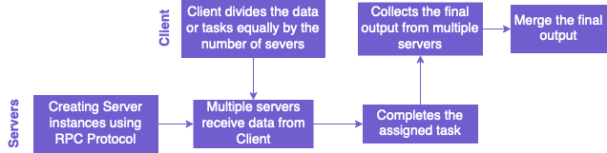
Method
Work flow of Distributed System

Slide 7
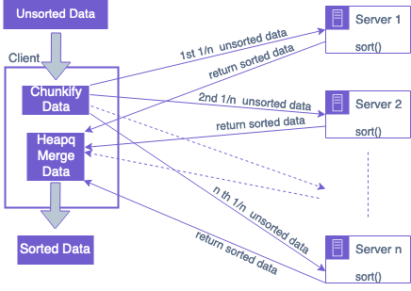
Method
Process of Sorting in Distributed System

Slide 8
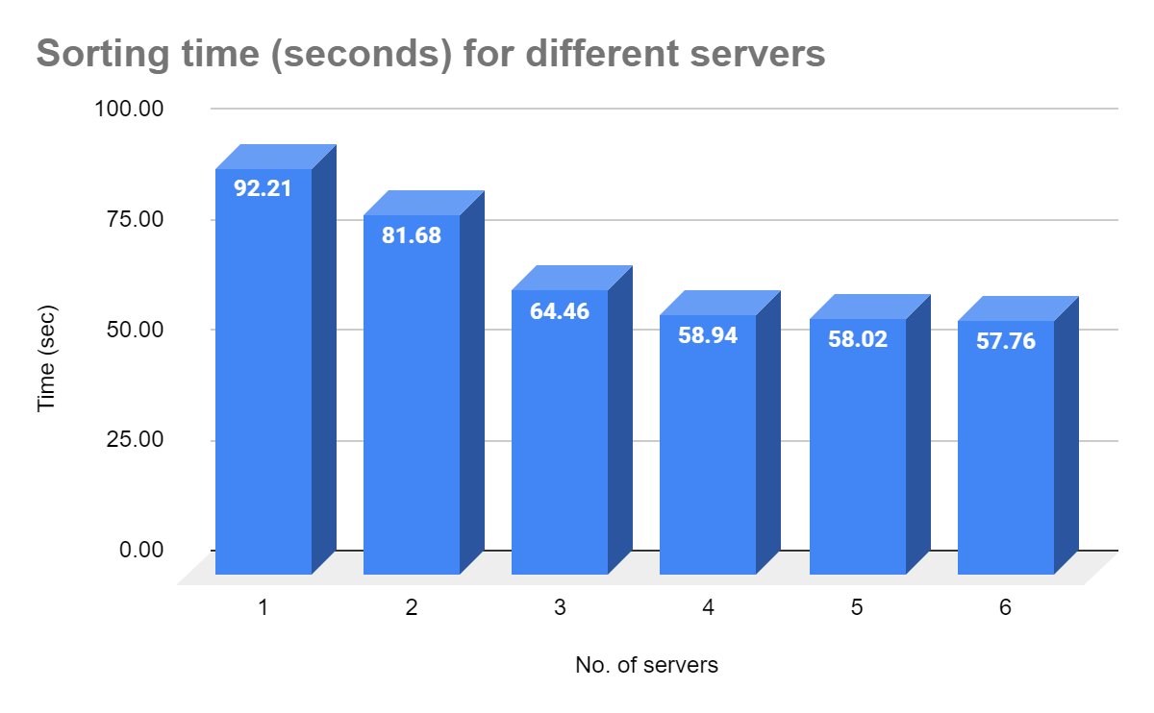
Results

Slide 9
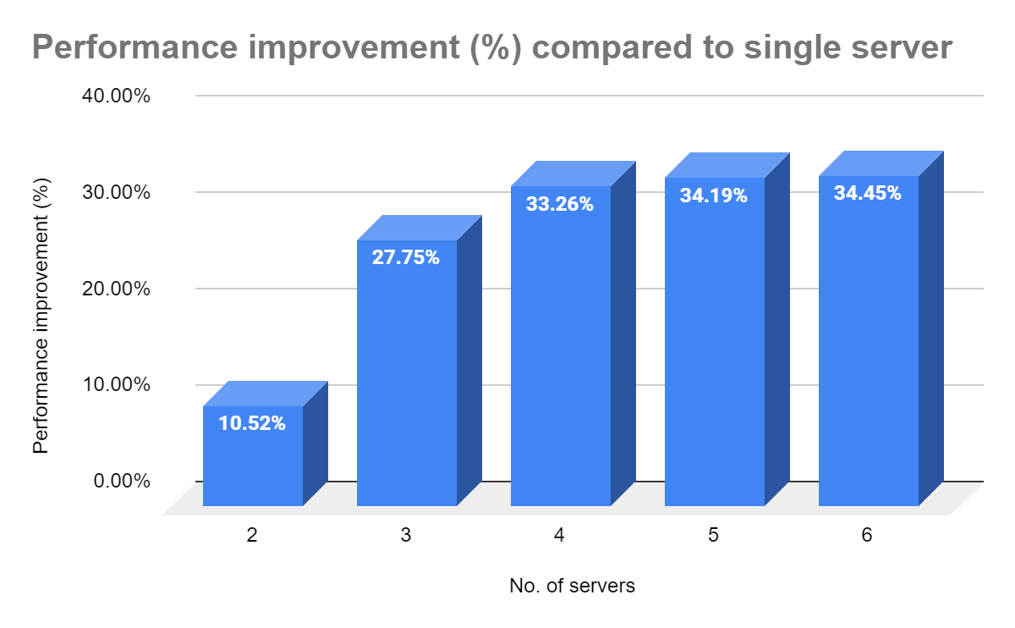
Results

Slide 10
Conclusion
Bangladesh’s stock market
Hidden Markov Model (HMM)
Strong probabilistic framework
Accuracy level is high
Limitations
Provide less company for prediction

Slide 11
Hard work beats talent when talent doesn’t work hard — Tim Notke

Slide 12
THANKS!
Any questions?

